Slide 1
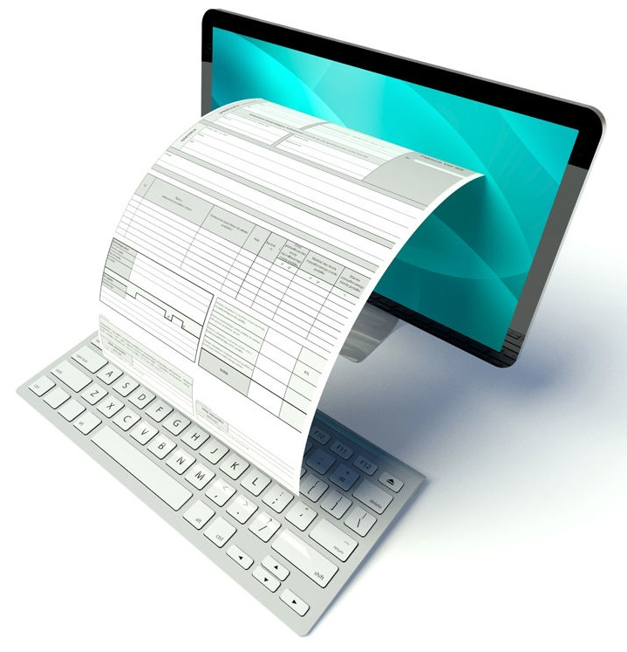
Computer based filing system
Moving from paper based filing system to computer based.
Cloud.
Secure.
Back up.

Slide 2
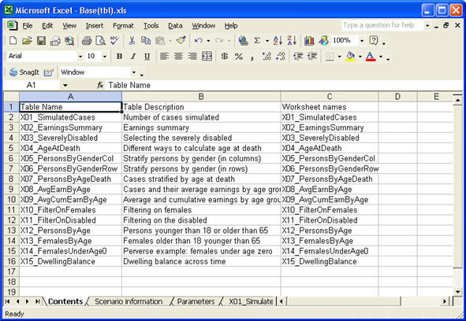
Microsft Excel
Can replace current system but not a good solution.

Slide 3

PHP and MySQL
Databases for data storage.

Slide 4
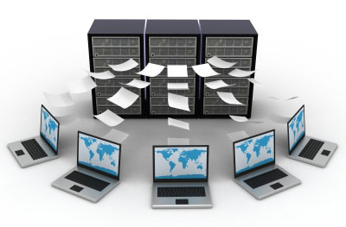
Client-server database communication
Multiple clients can access cloud data from anywhere.
Eg. If user has to use service away from the workstation.

Slide 5
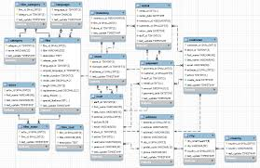
Relational Database
Relational database model.
All the information is connected.
Eg. A user enters a person who just got a stand. That person’s name is connected to the serial number o the stand which is also connected to who made that stand.

Slide 6

Website
A website that a person can log into.

Slide 7

HTML5
Used to build the website.

Slide 8

NodeJS
Used for server I/O in web apps.

Slide 9
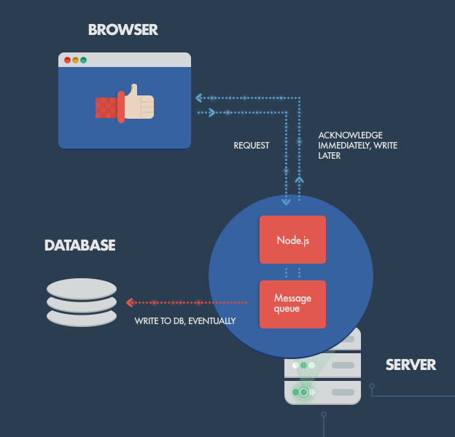
Handling web requests

Slide 10

CSS for UI
Designing an efficient user interface.

Slide 11
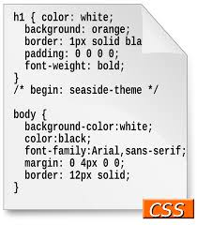
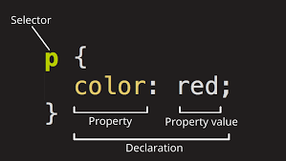
Example

